Slide 1
Tools to support development in JAVA

Slide 2
Highlights
Documentation
Organization => Compile Chain
Debugging
Monitoring
Pre-compiler
Retro-Compilation
Obfuscator
Performance analyzer
Conformance test
Continuous integration
Versioning

Slide 3
Documentation
Javadoc (JDK)
Automatic generation of HTML documentation
Using comments in java files
Syntax
/**
This is a <b>doc</b> comment.
@see java.lang.Object
@todo fix {@underline this !}
*/
Includes
class hierarchy, interfaces, packages
detailed summary of class, interface, methods, attributes
Note
Add doc generation to your favorite compile chain

Slide 4
Coding Conventions
To simplify code review
Rules on the coding style :
Apache, Oracle and others template
Verification tools
CheckStyle, PMD, JackPot, Spoon VSuite…

Slide 5
Tools to Improve your Source code
Formatting tools
Indenteurs (Jindent), beautifiers, stylers (JavaStyle), …
« bug fixing » tools
Spoon VSuite, Findbugs (sourceforge) …
Quality report tools : code metrics
Number of Non Comment Code Source), Number of packages, Cyclomatic numbers, …
JavaNCCS, Eclipse Metrics …

Slide 6
Compile chain
Tools
make, gmake, nmake (Win),
Apache ANT, Apache MAVEN, Freshmeat 7Bee ...
To automate:
pre-compilation, obfuscation, verification
generation of .class and .jar
normal, tracing, debug, …
documentation generation
« stubs » generation (rmic, idl2java, javacard …)
test
– …

Slide 7
Maven
Goal
Separation of concerns applied to project build
Compilation, code generation, unit testing, documentation, …
Handle project dependencies with versions (artifacts)
Project object model (POM)
abstract description of the project
Property inheritance from POM parents
Tools (called plugin)
To compile, generate documentation, automate test …
Note: more and more useful !

Slide 8
Maven Motivation
Abstract project model (POM)
Object oriented, inheritance
Separation of concerns
Default lifecycle
Default state (goals) sequence
plugins depend on states
Give a project « standard » structure
Standard naming conventions
Standard lifecycle
Automatic handling of dependencies between projects
Chargement des MAJ
Project repositories
public or private, local or remotes
caching and proxy
Extensible via external plugins

Slide 9
Maven plugins
Core
clean, compiler, deploy, install, resources, site, surefire, verifier
Packaging
ear, ejb, jar, rar, war, bundle (OSGi)
Reporting
changelog, changes, checkstyle, clover, doap, docck, javadoc, jxr, pmd, project-
info-reports, surefire-report
Tools
ant, antrun, archetype, assembly, dependency, enforcer, gpg, help, invoker, one (interop Maven 1), patch, plugin, release, remote-resource, repository, scm
IDEs
eclipse, netbeans, idea
Others
exec, jdepend, castor, cargo, jetty, native, sql, taglist, javacc, obr …

Slide 10
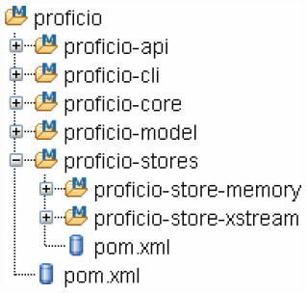
Project hierarchies
Motivations
Organize development in sub-projects
With N levels (N>=1)
Technique
Create a super POM (type pom) for each nesting level
Place shared plugins/goals at the same level
Subprojects (called modules) inherit from this super pom
Example
Command
mvn clean install
Global construction
Notes:
Créer des hiérarchies avec des projets, des ensembles de sous projets , etc… On met un fichier POM à chaque niveau. On a des dépendances entre les projets. Si on se place dans un sous projet, on compile que le sous projet.

Slide 11
Maven plugin for JAVA IDE
Maven plugins exists for
Eclipse (does not work particularly well ☹)
Intellij
NetBeans
– …

Slide 12
Debugging
Symbolic debugging
javac options: -g, -g:source,vars,lines
command-line debugger : jdb (JDK)
commands look like those of dbx
graphical « front-ends » for jdb (AGL)
Misc
Multi-threads, Cross-Debugging (-Xdebug) on remote VM
, ...
Notes:
Pour utiliser le debuger, appuyer sur le bouton compilation avec l’insecte. Placer un break point un peu avant le problème. Le programme se lance jusqu’à atteindre le break point. Ensuite on peut lancer le programme pas à pas. On peut aussi explorer les valeurs des variables.

Slide 13
Monitoring
Tracer
TRACE options of the program
can slow-down .class with TRACE/←TRACE tests
solution : use a pre-compiler (excluding trace calls)
Kernel tools, like OpenSolaris DTrace (coupled with the JVM)
Logger
Record events on a registry, to be used at execution time or later on (via some event handlers)
Tools
Apache Log4J, ObjectWeb MonoLog
Package java.util.logging since J2SE1.4
Logger, LogRecord, Handler
Notes:
Logger à la place des S.O.P. On peut configurer où ils écrivent (console ou fichier). Plusieurs niveaux de log : erreur, warning, infos et debug.
Quand on exécute un logiciel on peut choisir le niveau de log que l’on veut voir. Si on choisit debug (on voit toutes les niveaux). Si on choisit erreur, on voit juste les erreurs.

Slide 14
Validation (i)
Assertion
Pre-Condition, Post-Condition, Invariant
EIFFEL, CLU ... built-in
Java since SE 1.4
Tools for J2SE 1.3 et less (J2ME, JavaCard, …)
AssertMate (Reliable Software Technologies)
http://www.ddj.com/articles/1998/9801d/9801d.htm#rel
JML (Java Modeling Language)
http://www.eecs.ucf.edu/~leavens/JML/
iContract (Reliable Systems)
…
Design by Contract with JML (by Gary T. Leavens and Yo
Notes:
Assertion : Sert à vérifier les variables. Sert énormément dans les tests

Slide 15
Refactoring
Motivation
Reorganizing a set of code sources
without modifing the external behaviour
Package tree
New methods
Changing parameters
Built-in support in all modern IDEs
Batchs jarjar
Notes:
Refactoring : Modifier le code source pour changer sa forme, le concevoir d’une meilleure façon.
Permet de modifier une variable ou une méthode (changement de nom), la modification se fait partout.
On sélectionne le nom de la méthode, clic droit, source/refactor, rename

Slide 16

Reverse-compilation
Bytecode decompilation
from Java .class to Java source
Partial/Total
« attacker » goals
name of a bean, class, methods, comments, traces, debugging informations, have a meaning
to discover the algorithms behind a business component, to modify its source (ie, to delete license verification code), to hack it...
Developer risks:
Copyright losses, loss of incomes ...
Notes:
Compilation inverse : Sert si on a perdu le code source du logiciel et qu’on a que le code compilé.

Slide 17
First pass: The Obfuscator
Goal : Avoid bytecode interpretation done by retro-compilers
Solution : make the source code unreadable before distribution
Techniques applied by these tools:
transformation of classes names, methods, attributes (a0001, …)
mix attribute visibility (public, private, …)
delete debugging informations
Note : delete your traces and debug informations
Attention : makes hard to mantain your code « Error a238 : send this message to our helpdesk debug@mycomp.com »
Other usecase: reduce code footprint for very restrained platforms (J2ME/CDLC)
Notes:
Rendre le code source illisible pour ne pas se faire voler le code.
Réduire la taille du code.

Slide 18
Second pass: Watermarking
Goal : test retro-compilation and its usage
How
http://www.cs.arizona.edu/sandmark/
Add a datastructure W inside a program P
W must be recognizable/trackable ! (for testing) and robust to translation, optimization, obfuscation;
Notes:
Faire en sorte de prouver que quelqu’un a copié et volé notre code source
On insère des choses qui ne servent à rien donc si quelqu’un à la même chose c’est qu’il y a une copie

Slide 19

Decompilers and Obfuscators
Decompilers
JDK javap, WingDis, NMI ’s Java Code Viewer, JAD, DeCafe, …
Obfuscators
Mocha Source Obfuscator, WingDis, NMI ’s Java Code Viewer, JAD, Hashjava, Jmangle, Zelix KlassMaste, RetroGuard, Dash-O, …
Digg more:
Dave Dyer, Java decompilers compared, JavaWorld (July 1997), http://www.javaworld.com/javaworld/jw-07-1997/jw-07- decompilers.html
Qusay H. Mahmoud, Java Tip 22: Protect your bytecodes from reverse engineering/decompilation, http://www.javaworld.com/javatips/jw- javatip22i.html

Slide 20
Licensing
Some numbers
Illegal use of software
50% in Europe
95% in Asia, South America, Eastern Europe
Loss of income for developers
$12 billions/year world-wide
$3 billions/year in USA only

Slide 21
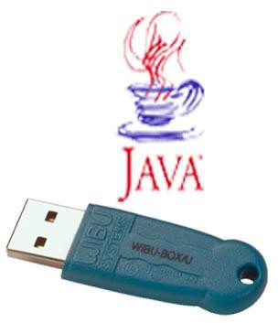
Licensing
Software
Class verify the signature of (Nom+Société+@MAC+Key)
Key is sent after Web registration
Stop lauching and execution in several point if the signature is erroneous
☹ Replicated N times the same key !
☹ hastalavista.sk
☹ Cracking (license checking is bypassed)
☹ Patch supress licence checking
Hardware
Customer VM / Custom ClassLoader
CL or VM uses a decryption Key (present in a Dongle or SmartCard) to
decrypt encrypted bytecode and verify the signature
Presence of the dongle is checked regulary

Slide 22
Performances
Measure/Analyze
Benchmark
java.awt.Robot (to build clients for testing)
Accounting : http://abone.unige.ch/jraf/index.htm
JProfiler, OptimiszeIt …
Optimization
See books:
Steve Wilson, Jeff Kesselman, « Java Platform Performance: Strategies and Tactics (The Java Series) », 1 edition (May 25, 2000), Addison-Wesley Pub Co; ISBN: 0-201-70969-4
Jack Shirazi, “Java Performance Tuning”, Ed Oreilly, 2000, ISBN 0-596-00015-4
Notes:
D’abord rendre le logiciel performant et fonctionnel puis l’optimiser par la suite

Slide 23
Choosing the JVM and JRE
Some criteria
License, redistribution, supports, performances, contraintes (embedded, servers, réal-time, …), runtimes, …
Examples
Sun HotSpot JVM + JRE
MicroSoft JVM (deprecated)
IBM J9
BEA JRockit
HP Chai
Macromedia JRun
Blackdown JVM
Kaffe + GNU Classpath
CReME
Cacao http://www.cacaojvm.org/
Apache Harmony
JamVM
JRate
…

Slide 24
Test
Tools to manage tests
« Test » every possible case
Unit Test
JUNIT (http://www.junit.org) the most famous
Cactus (for Servlets)
Jcover (CodeWork)
Coverage test
See methods or code branches not covered by tests.
Quilt (http://quilt.sourceforge.net)
Continuous integration
Notes:
JUNIT permet de faire des test : On lance le logiciel, on appelle les méthodes et on vérifie le résultat des méthodes par rapport à ce que l’on attend

Slide 25
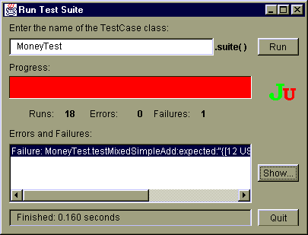
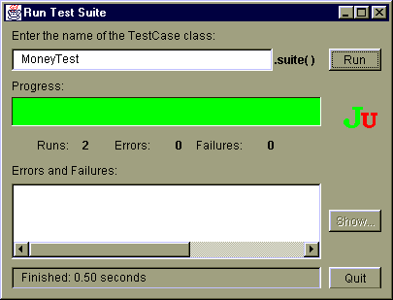
Unit Test
JUnit 3 and 4 http://www.junit.org
Test pattern
Test, TestSuite, TestCase
Assertions (assertXX) that must be verified
TestRunner
Chain tests and output a report.
See JUnit course:
http://www-adele.imag.fr/users/Didier.Donsez/cours/junit.pdf

Slide 26
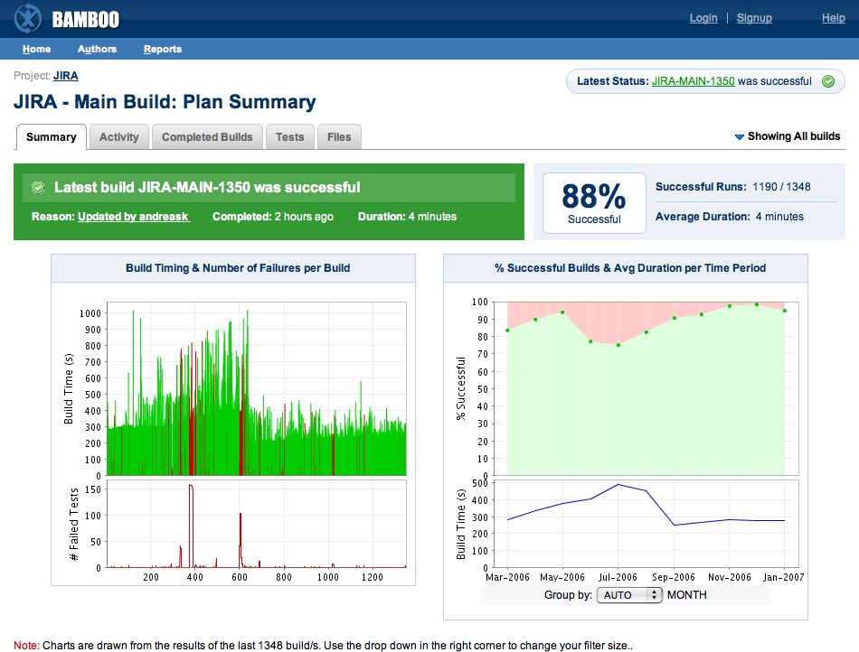
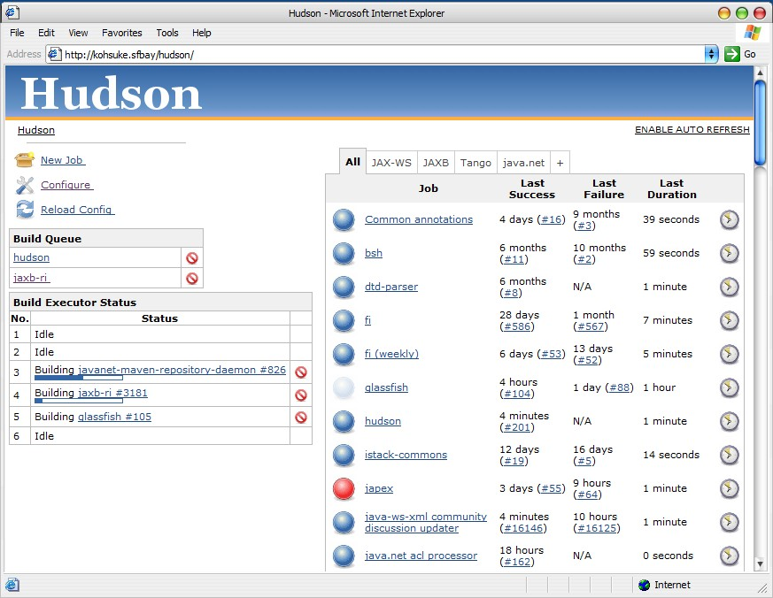
Continous integration
Principe
Schedule periodically test execution, nightly builds, …
Example : Continuum, Bamboo, Hudson, JENKINS …
Notes:
Prendre le système qui fait la chaine de compilation et de périodiquement construire la compilation de notre projet et vérifier si ça marche.

Slide 27
Improving Your Productivity
Continuous integration can help you go faster
Detect build breaks sooner
Report failing tests more clearly
Make progress more visible
Notes:
Permet d’améliorer la productivité

Slide 28

Jenkins for Continuous Integration
Jenkins – open source continuous integration server
Jenkins (http://jenkins-ci.org/) is
Easy to install
Easy to use
Multi-technology
Multi-platform
Widely used
Extensible
Free

Slide 29
Jenkins for a Developer
Easy to install
Download one file – jenkins.war
Run one command – java –jar jenkins.war
Easy to use
Create a new job – checkout and build a small project
Checkin a change – watch it build
Create a test – watch it build and run
Fix a test – checkin and watch it pass
Multi-technology
Build C, Java, C#, Python, Perl, SQL, etc.
Test with Junit, Nunit, MSTest, etc.

Slide 30
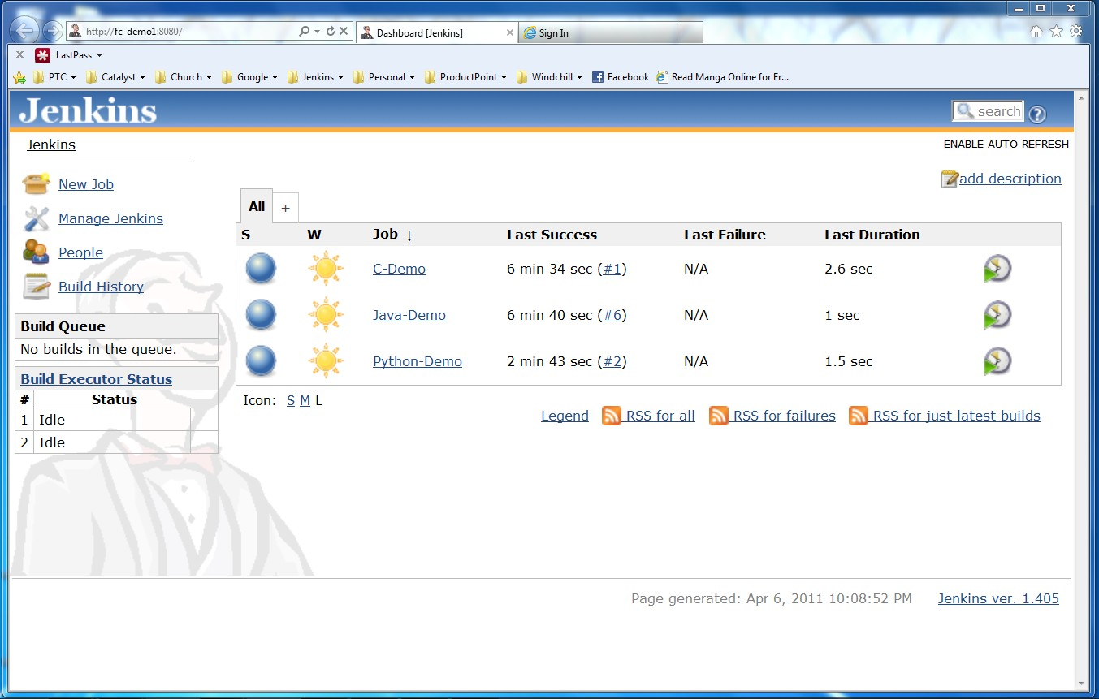
Jenkins User Interface
Actions
Nodes
Jobs

Slide 31
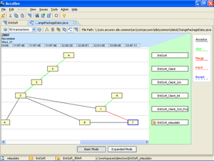

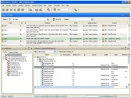




Jenkins Plugins - SCM
Version Control Systems
Accurev
Bazaar
BitKeeper
ClearCase
Darcs
Dimensions
Git
Harvest
MKS Integrity
PVCS
StarTeam
Subversion
Team Foundation Server
Visual SourceSafe

Slide 32
Jenkins Plugins – Build & Test
Build Tools
Ant
Maven
MSBuild
Cmake
Gradle
Grails
Scons
Groovy
Test Frameworks
Junit
Nunit
MSTest
Selenium
Fitnesse

Slide 33
Jenkins Plugins – Analyzers
Static Analysis
Checkstyle
CodeScanner
DRY
Crap4j
Findbugs
PMD
Fortify
Sonar
FXCop
Code Coverage
Emma
Cobertura
Clover
GCC/GCOV

Slide 34
Jenkins Plugins – Other Tools
Notification
Twitter
Campfire
Google Calendar
IM
IRC
Lava Lamp
Sounds
Speak
Authorization
Active Directory
LDAP
Virtual Machines
Amazon EC2
VMWare
VirtualBox
Xen
Libvirt

Slide 35
Measurements and Analysis of Performances
Java Profiler
Use to profile an application
CPU usage, Memory, Network, time spent, and Garbage collection
In Total or by threads, or called methods
Notes:
Permet de voir l’utilisation des différentes ressources
Carbage collector : C’est le truc qui fait que JAVA est utilisé mais c’est ce qui fait que JAVA est limité. C’est un algorithme qui tourne et qui vérifie dans la mémoire les objets qui sont dans la mémoire mais qui ne sont plus utilisés dans le programme puis il les supprime. Il peut prendre énormément de temps sur une application.

Slide 36
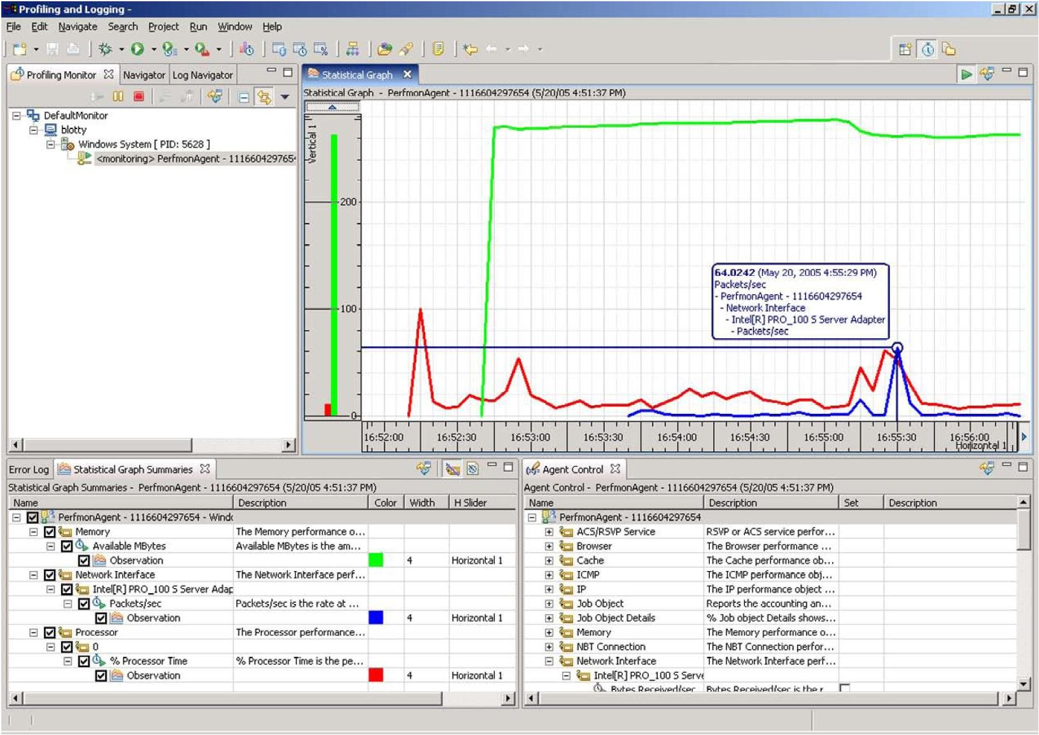
Exemple
Eclipse TPTP http://www.eclipse.org/tptp/

Slide 37
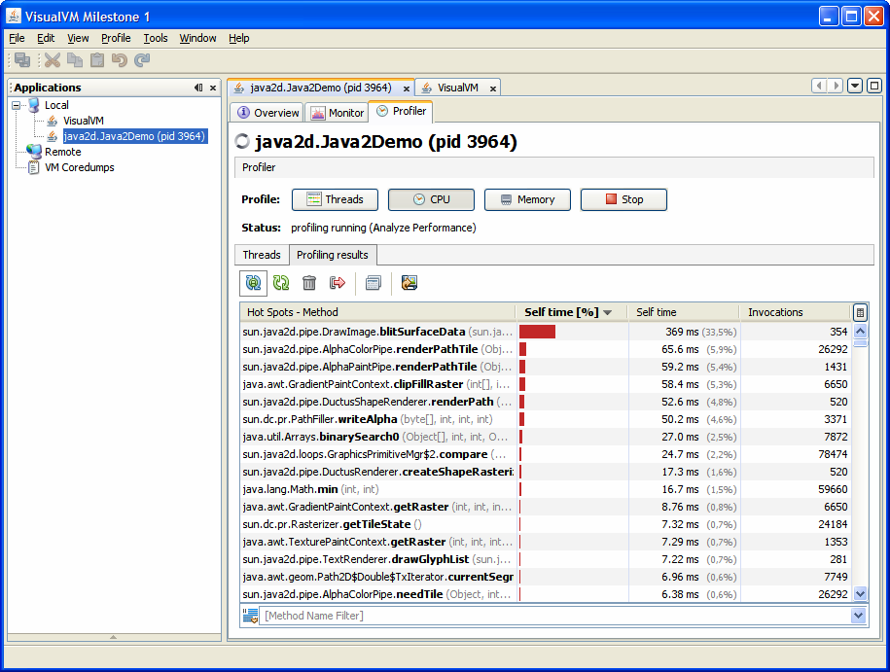
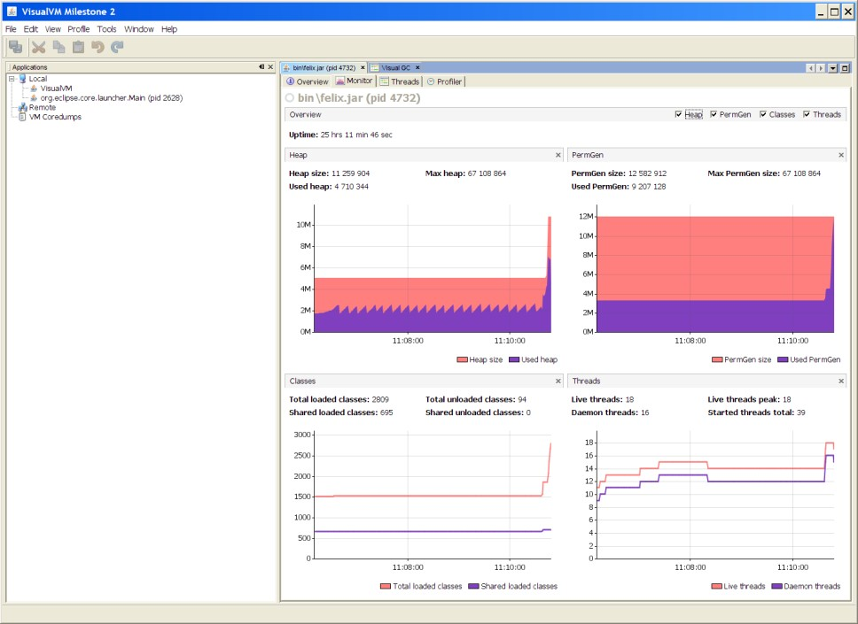
VisualVM
https://visualvm.dev.java.net/
« VisualVM is a visual tool that integrates several existing JDK software tools and lightweight memory and CPU profiling capabilities. This tool is designed for both production and development time use and further enhances the capability of monitoring and performance analysis for the Java SE platform.»
VisualVM includes the JConsole.
http://weblogs.java.net/blog/mandychung/archive/VisualVM-BOF-2007.pdf

Slide 38
Performance Optimizations
Java’s Script Engine
Jython (jython.sourceforge.net), …
Bytecode interpreter
Native compiler (static)
.class to .c to .s to .exe
On-the-fly compiler (dynamic)
Compilation JIT (Just-In-Time) de Symantec
HotSpot™ Optimizer
garbage collector
« method inlining »
with load-time verification (dynamic) of class bytecode
Benchmark de JVM

Slide 39

Code Quality Metrics
Metrics on project source code to evaluate its quality (maintenance,reverse-engineering,evolution …)
and how good the development team is :-)
Metrics
LOC, LOCC, McCabe Cyclomatic Complexity, …
Lectures
Brian Henderson-Sellers , "Object-Oriented Metrics, measures of Complexity", Ed Prentice
Hall, 1996
Robert Martin, "OO Design Quality Metrics, An Analysis of Dependencies", 1994, http://www.objectmentor.com/resources/articles/oodmetrc.pdf
Chidamber and Kemerer, A Metrics Suite for Object Oriented Design, http://www.pitt.edu/~ckemerer/CK%20research%20papers/MetricForOOD_ChidamberKem erer94.pdf
Mariano Ceccato and Paolo Tonella, Measuring the Effects of Software Aspectization, http://homepages.cwi.nl/~tourwe/ware/ceccato.pdf
Robert Martin, "Agile Software Development, Principles, Patterns and Practices", Prentice Hall, 1st edition, 2002, ISBN: 978-0135974445

Slide 40
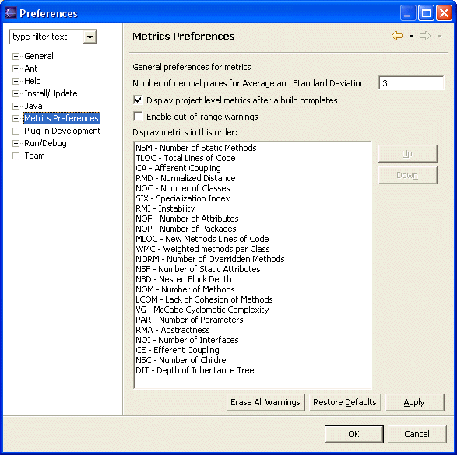
Code Quality Metrics
Example: Metrics (Tache ANT + Eclipse plugin)

Slide 41
Code Quality Metrics
Others (standalone or as IDE plugins)
http://metrics.sourceforge.net/
http://qjpro.sourceforge.net/
http://www.geocities.com/sivaram_subr/index.htm
…

Slide 42
Versioning of source code
Collaborative software engineering
To master
software development by very large developer teams
parallel implementations (experiments, vendors)
Goals
Increase productivity of developers and software robustness
Low-down development costs
Manage software system configuration
to control software system’s evolution
evolution tracking (time-machine)
issue and bug tracking

Slide 43
Versioning : What for?
History of versions
back to an older version in case of errors
Alternative versions (branching)
different design/implementations
(maybe experimentals) for the same module
Collaborative access by many developers
audit modification history
how many commits by X ?
when most of the commits are done?
...

Slide 44
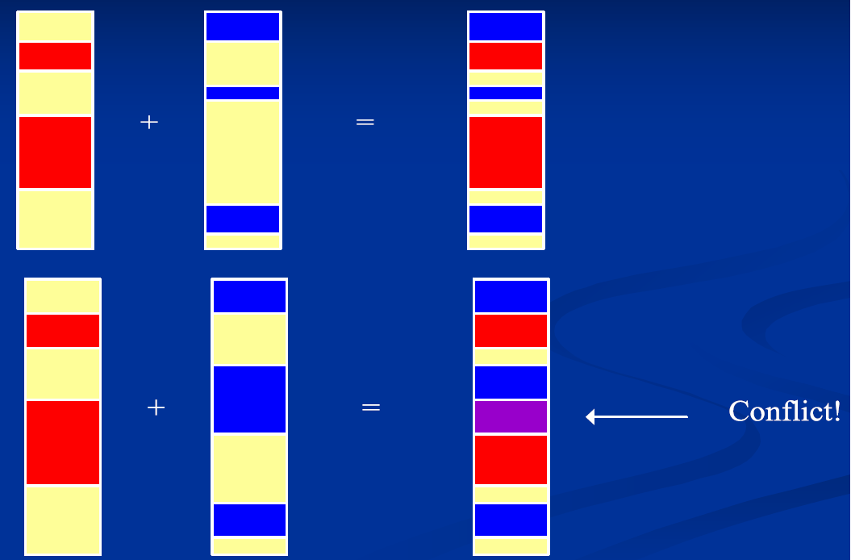
Concurrency management

Slide 45
Concurrency control
Doing nothing!
Lock-Modify-Unlock (Pessimistic)
SCCS, RCS
Decrease productivity
Copy-Modify-Merge (Optimistic)
Conflicts resolution when concurrent modifications (which are actually rare)
Merge, Selection, …
CVS, SVN : Client level resolution
Policy-based
Merging and validation process for each code contribution

Slide 46
Concept of Version
Trunk
main development
Branches
Alternatives to trunk
Different design/implementation (experimental), vendor- specific
Revisions
Sequence of versions
Tags
Symbolic references to revisions (Tiger, LongHorn, …)
Represent a public release (R), a milestone (M)
Branch merging

Slide 47
Tools
Pioneers
SCCS, RCS, PVCS
Current alternatives
CVS
SubVersion
Git
MS Visual SourceSafe
ChangeMan (Serena)
AllFusion Harvest (CA)
ClearCase (IBM Rational)
Perforce
CM Synergy (Telelogic)
Source Integrity (MKS)
PVCS (Merant)
TeamCode (Interwoven)
Surround CM (Seapine)
Web-Oriented protocols
WebDAV/DeltaV

Slide 48
Git
version control system
designed to handle very large projects with speed and efficiency
mainly for various open source projects, most notably the Linux kernel.
http://git.or.cz/
Notes:
Permet la gestion de très gros projet

Slide 49
Tools to use Git
SmartSVN
GitHub => provide the whole forge with a GIT installed
– Free for open-source project

Slide 50
Centralized Version Control
Traditional version control system
Server with database
Clients have a working version
Examples
CVS
Subversion
Visual Source Safe
Challenges
Multi-developer conflicts
Client/server communication

Slide 51
Distributed Version Control
Authoritative server by convention only
Every working checkout is a repository
Get version control even when detached
Backups are trivial
Other distributed systems include
Mercurial
BitKeeper
Darcs
Bazaar

Slide 52
Git Advantages
Resilience
No one repository has more data than any other
Speed
Very fast operations compared to other VCS (I’m looking at you CVS and Subversion)
Space
Compression can be done across repository not just per file
Minimizes local size as well as push/pull data transfers
Simplicity
Object model is very simple
Large userbase with robust tools

Slide 53
Git Architecture
Index
Stores information about current working directory and changes made
to it
Object Database
Blobs (files)
Stored in .git/objects
Indexed by unique hash
All files are stored as blobs
Trees (directories)
Commits
One object for every commit
Contains hash of parent, name of author, time of commit, and hash of the
current tree
Tags

Slide 54
Some Commands
Getting a Repository
git init
git clone
Commits
git add
git commit
Get changes with
git fetch (fetches and merges)
git pull
Propagate changes with
git push

